Slide 1
COVID-19 New Orleans Response & Vaccine Updates
Jennifer Avegno, MD
Director, New Orleans Health Department
March 10, 2021

Slide 2
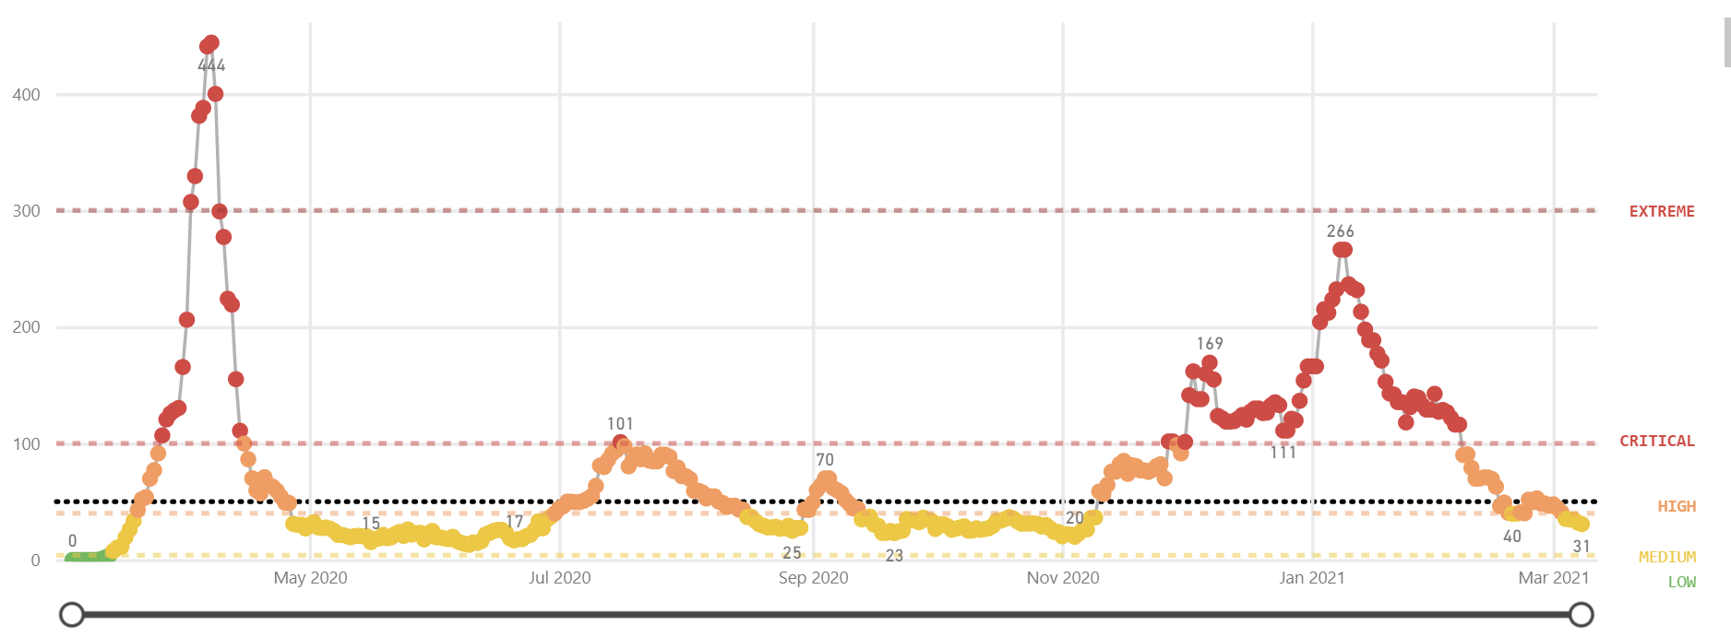
COVID-19 in New Orleans - one year later
From early hotspot to mitigation and recurrent “ripples” of surge
>25 cases/100k Widespread outbreak
10-25 cases/100k at risk of outbreak
1-10 cases/100k
<1 cases/100k Low transmission
>75 cases/100k
Severe outbreak
Initial surge
Universities
Holiday/
national surge
Phase 2

Slide 3
Current status (as of 3/9/21)
2.6% case fatality rate
762,463 total tests
27,398 cases
719 confirmed deaths
1.5%
positivity
31
current avg cases/day

Slide 4
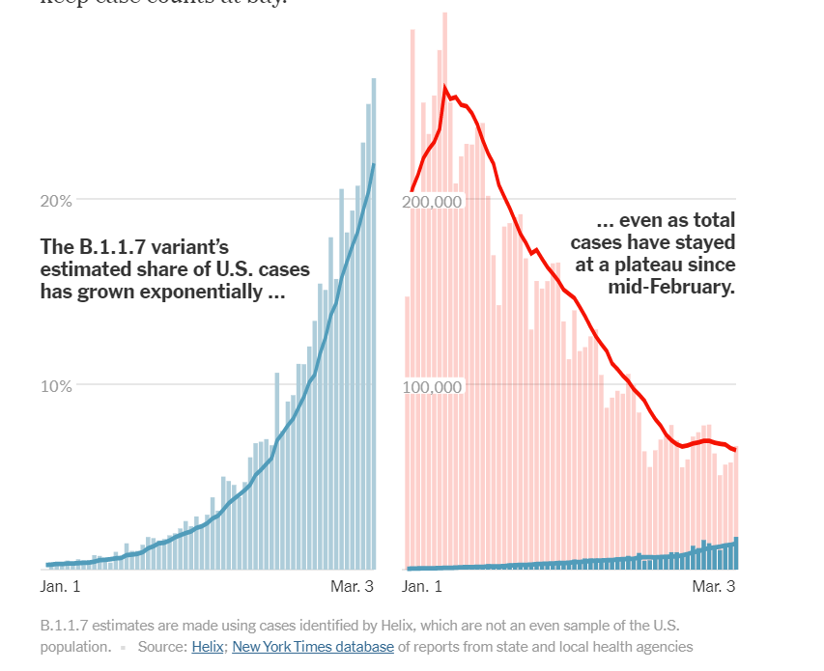
Current challenges
CDC guidance to refrain from opening up too soon
50% of the confirmed variant cases in Louisiana are in the New Orleans region
As measured by covidactnow, Orleans Parish scores highly on the Social Vulnerability Index, meaning its residents are more likely to experience severe physical and economic suffering from COVID

Slide 5
Modified Phase 3
Same as State Phase 3 Guidelines
Retail, restaurants, salons, tattoo services, movie theaters, museums, offices allowed to increase to 75% capacity
Bars and breweries allowed to increase to 50% capacity
More restrictive than State Phase 3 Guidelines
Gathering sizes capped at 75 indoors, 150 outdoors
Sporting venues limited to 15% capacity indoors, 25% capacity outdoors
Houses of worship limited to 75% capacity
Fairs, festivals, and carnivals limited to 50% capacity with a max of 75 people indoors, 150 outdoors
Gyms and fitness center remain at 50% capacity
Concert and music halls with fixed, permanent seating allowed to increase to 75% capacity with a max of 250 people
Conference venues remain at 50% capacity
Event venues limited to 50% capacity with a max of 75 people indoors, 150 people outdoors

Slide 6
Vaccines: the way forward
Vaccine Development
FDA Authorization
Priority Groups
Overlapping phases shorten development time during an outbreak.
Multiple COVID-19 vaccines were given tremendous resources to complete all steps
The FDA is responsible for approving all vaccines.
During pandemics, new vaccines receive an emergency-use-authorization if they are over 50% effective and shown to be safe through clinical trials.
The Advisory Committee on Immunization Practices is a group of non-governmental, non-partisan medical and public health professionals that make national recommendations on all vaccines.
ACIP issues recommendations regarding who should receive each vaccine once it receives the EUA.
Builds on science in development for decades.

Slide 7
3 Effective, Safe Choices
 | Moderna | Pfizer | Johnson & Johnson
How it works | mRNA | mRNA | Modified adenovirus
How you get it | 2 doses, 28 days apart | 2 doses, 21 days apart | 1 dose
Age limit | 18+ | 16+ | 18+
How many people tested it | 30,000 volunteers from US, all groups | 43,000 volunteers from 6 countries, all groups | 43,000 volunteers from 8 countries, all groups
How well it protects | 97-100% effective in preventing death & hospitalization 100% prevention of severe disease 94% prevention of symptomatic disease | 100% effective in preventing death & hospitalization 99% prevention of severe disease 95% prevention of symptomatic disease | 100% effective in preventing death & hospitalization 85% prevention of severe disease 72% prevention of moderate to severe disease
How long before full protection | 2 weeks after 2nd dose | 1 week after 2nd dose | 28 days after dose
Common side effects | Site pain, chills, headache, mild fever, tiredness | Site pain, chills, headache, mild fever, tiredness | Site pain, chills, headache, mild fever, tiredness

Slide 8
Who is eligible?
As of 3/9/2021
All individuals 65 & older
Individuals 16 & older with certain medical conditions
High risk occupations such as healthcare workers, first responders, school staff, congregate living staff, and others

Slide 9
Current Vaccination status (as of 3/9/2021)
NOLA
21.4%
11.9%
LA
16.9%
9.7%
USA
18.4%
9.7%
Series started
Fully vaccinated

Slide 10
Equity and access
Removing barriers:
Citywide waitlist
Sites in your neighborhood – Central City, Lower 9, West Bank, Gentilly, 7th Ward, Hollygrove, Downtown
Transportation, including RTA and rideshare pilot coming soon
Homebound vaccination
Door-to-door canvassing, text alerts, Sleeves Up, NOLA campaign
Notes:
Uberhealth pilot
Race stats on death & vaccines
We are in your neighborhood

Slide 11
Frequently Asked Questions
What information do you need to sign up for a vaccine?
Who should or shouldn’t get the vaccine?
Are vaccines free?
How long do side effects last?
How safe are the vaccines?
Which vaccine should I get?
Should I get the vaccine if I have already had COVID-19?
I have a strong immune system. Why do I need a vaccine?

Slide 12
How does life change when I’m vaccinated?
CDC guidance
Fully vaccinated individuals:
must continue full masking and distancing when outside their household
may visit with other fully vaccinated people indoors in small numbers only without masking or distancing
must continue to be vigilant and adhere to guidelines when visiting with non-vaccinated individuals

Slide 13
How to access vaccine
CALL 311 to be placed on the City Wait List
Register for the Wait List online at
ready.nola.gov/getvaccine
Search for a provider near you:
https://ldh.la.gov/covidvaccine-locations/

Slide 14
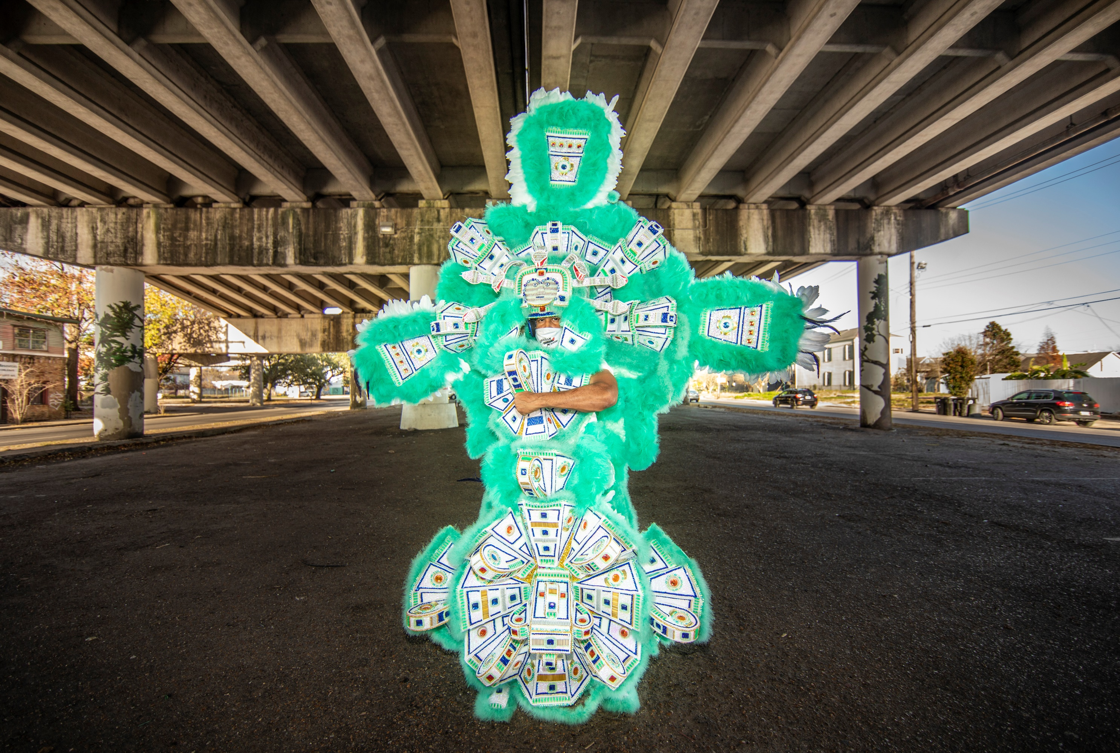
Frequently asked questions
Sleeves Up, NOLA!

